Slide 2
Digital Technology
TK1104
Guest lecturer: Peyman Teymoori
peymant@ifi.uio.no
Lecturer: Toktam Ramezanifarkhani
Toktam.Ramezanifarkhani@kristiania.no
Toktamr@ifi.uio.no

Slide 3
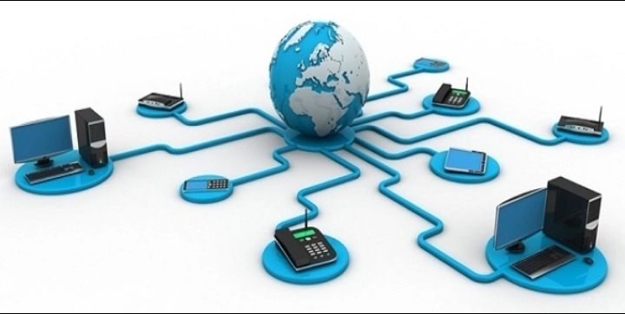
Computer Networks – Network Layer

Slide 4
Learning objectives
To learn about addresses on the Internet
IP, subnets
To learn debug the network using ICMP
ping, trace route
To understand how NAT (Network Address Translation) works
To get to use some basic networking commands in the terminal / prompt

Slide 5
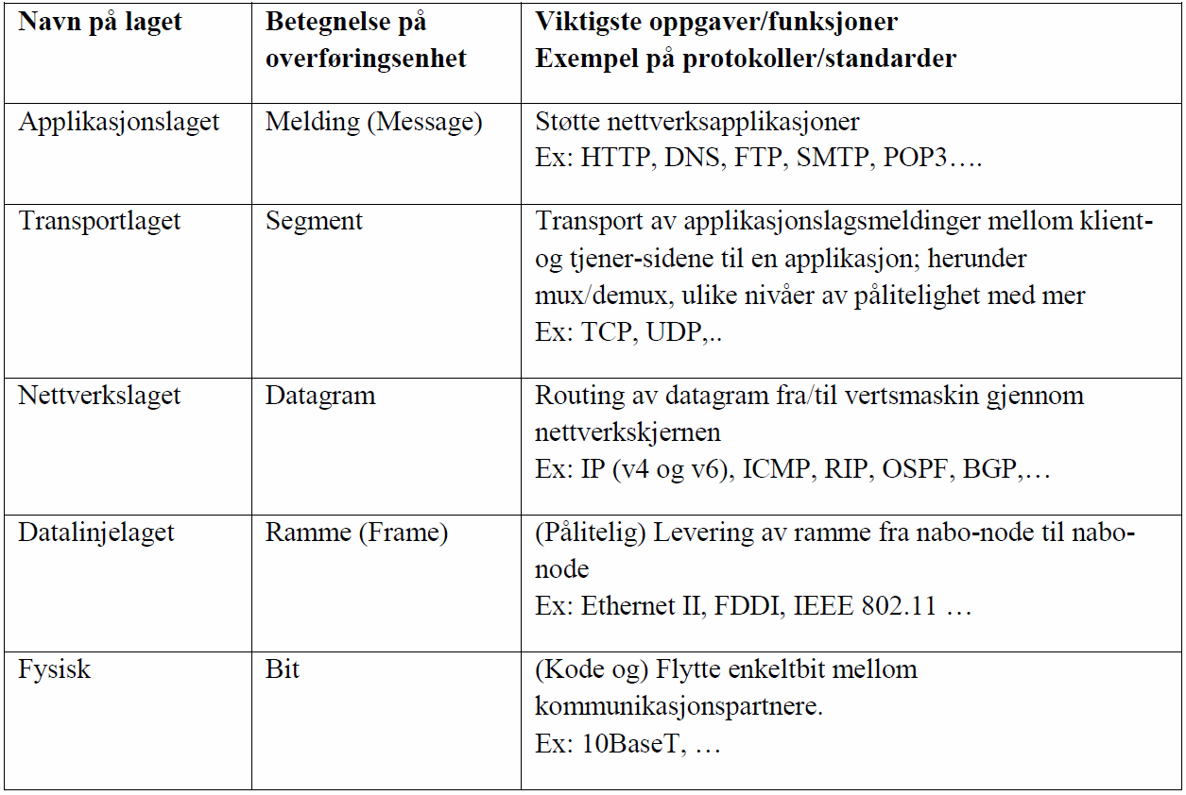
The network layer
Layer´s name
designation of transmission unit
Most important tasks / functions
Example of protocols / standards
Transport layer
transport of application layer messages between client and server pages of an application: including mux / demux, different levels of reliability and more ..
Ex: TCP, UDP ...
The network layer
routing of datagram from / to host through the network core
Ex: IP (v4 and v6) ICMP, RIP, OSPF, BGP
The data line layer
Frame
(Reliable) delivery of frame from neighbor node to neighbor node.
Ex: Ethernet II, FDDI, IEEE 802.11
Physical
(Code and) Move single bit between communication partners.
Ex: 10BaseT,

Slide 6
Datagram network (Internet)
No pre-setup at the network layer level
The routers do not care about the condition of the route
Stateless routers
The packets are routed based on the recipient ID
the packets between the same sender and receiver can follow different routes
Data can be lost in a router queue if the buffer is not large enough
application
transport
network
data link
physical
application
transport
network
data link
physical
1. Send data
2. Receive data

Slide 7
Internet Protocol v4

Slide 8
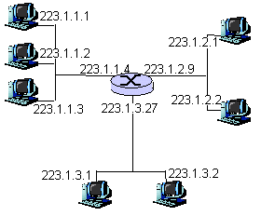
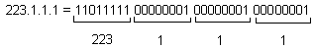
IPv4 addressing
IPv4 address: 32-bit «id» for each host and router interface (adapter)
A host can have multiple interfaces
A router usually has several connections, each with its own interface
IP address belongs to each interface

Slide 9
Exercise: what is my (local) IP address?
on Windows, go to command prompt and enter
ipconfig
on mac OS, go to terminal and enter
ipconfig getifaddr en0
ipconfig getoption en0 subnet_mask
on Android/iPhone
Click on the WiFi icon and then, click on the connected one!
Write it down somewhere!

Slide 10
IPv4 addresses: allocation
For hosts in LAN
Can be set manually / statically
Dynamic Host Configuration Protocol(DHCP)
For networks
Is assigned its share of the ISP's assigned address space
For Internet Service Provider (ISP)
International Agency (ICANN) assigns addresses, manages DNS, assigns domain names and resolves disputes.
“Continent registrar”: RIPE distributes IP addresses and AS numbers to Europe and others.

Slide 11
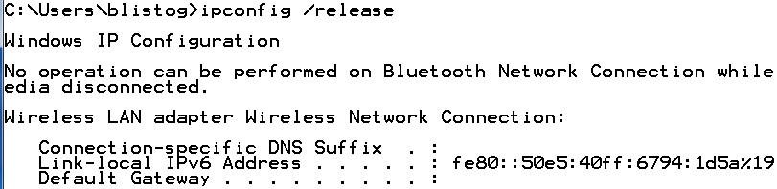
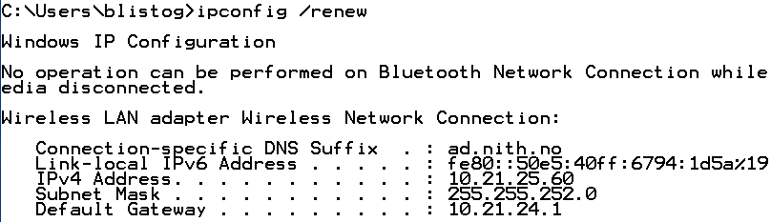
Dynamic Host Configuration Protocol
Each DHCP server has a set of possible addresses (pool)
Sets the address dynamically with "plug-and-play"
Host transmits : DHCP discover
DHCP server responds: DHCP offer
Host transmits : DHCP request
DHCP server transmits: IP address and other network parameters (eg DNS server) + DHCP ack
Hosting is set up with these values

Slide 12
Datagram from sender to recipient
Sender A, recipient E
Find the network address of E
E on another network
A, E not directly connected
Routing table: the next jump router to E is 223.1.1.4
The link layer sends the datagram to router 223.1.1.4 in the link layer frame
Datagram arrives 223.1.1.4
E on the same network as 223.1.2.9
Datagram is sent to 223.1.2.2
misc
fields
source
IP addr
reception
IP addr
misc
fields
223.1.1.1
223.1.2.2
data
data
A
223.1.1.1
223.1.2.1
223.1.1.2
223.1.1.4
223.1.2.9
223.1.2.2
223.1.1.3
223.1.3.27
E
223.1.3.1
223.1.3.2

Slide 13
IPv4 datagram-format
IP protocol version
32 bit
total datagram-
length (bytes)
header length
(byte)
head.
len
type of
service
ver
length
for
fragmentation /
composition
“type” data
flag
fragment
offset
16-bit ID
max number
remaining jump
(decremented in
each router)
time to
live
upper
layer
Internet
checksum
32 bit Sender IP-address
the protocol to be had
payload (TCP, UDP)
32 bit Recipient IP-address
Options (if any)
For example.
timestamp,
record route,
specify
list of routers
you have to stop by
data
(variable length,
usually a TCP
or UDP segment)
how much overhead with TCP?
Min 20 byte for TCP
Min 20 byte for IP
= 40 byte + app. lags overhead

Slide 14
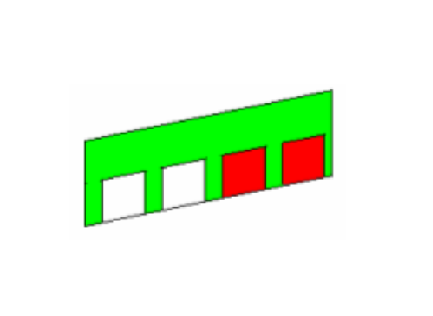
The subnet mask
The subnet mask indicates which bits are PREFIX and which are HOST
A subnet mask is a bitmask applied to an IP address.
Address 192.168.14.181, mask 255.255.0.0
181
14
168
192
0
192.168.14.181
255
0
AND
255.255.0.0
255
0
=
192.168.0.0
0
168
192

Slide 15
Ex: Which network?
Assume 10.21.26.184 with subnet mask 255.255.252.0
To which network does it belong?
10 . 21.0001 10 10.1011 1000
255.255.1111 11 00.0000 0000
10 . 21.0001 10 00.0000 0000
22 bits for prefix, 10 bits for host
The network is 10.21.24.0/22
Lowest address is 10.21.24.1
Broadcast is 10.21.27.255 all host bits set to 1 !!!
&

Slide 16
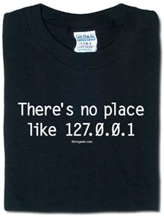
Special IP addresses
When booting, a machine can identify itself with a temporary address
0.0.0.0 (default route)
Loopback means addressing oneself
127.0.0.1
Many systems use 127.0.0.0/8
The lowest (network) and highest (broadcast) address are thus not used in ordinary addressing of hosts or routers

Slide 17
Subnet
223.1.1.2
How many subnets?
3 subnets / local networks
The routers have interfaces in different IP networks
3 "link networks" that connect the three subnets
6 different IP networks / subnets
1
223.1.1.1
223.1.1.4
223.1.1.3
223.1.9.2
223.1.7.0
4
5
223.1.9.1
223.1.7.1
223.1.8.1
6
223.1.8.0
223.1.2.6
223.1.3.27
2
3
223.1.2.1
223.1.2.2
223.1.3.1
223.1.3.2

Slide 18
Internet Control Message Protocol (ICMP)

Slide 19
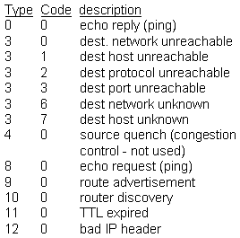
ICMP - Internet Control Message Protocol
Used by host, router and gateway
Error reporting
Echo request / response
(ping)
ICMP-message
Type, code and first 8 bytes in the datagram with the error
ping and tracert often utilizes ICMP

Slide 20
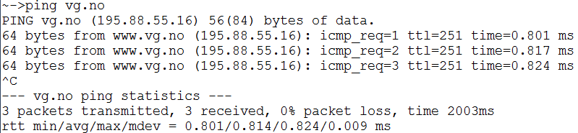
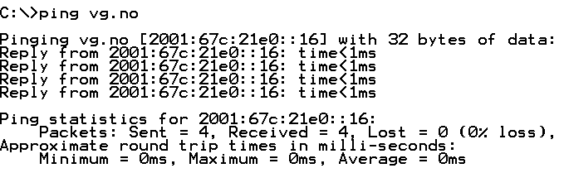
ping
Sends an ICMP echo package to the specified address
Useful for checking if the IP address exists and can be reached.

Slide 21

Exercise: ping your classmate

Slide 22
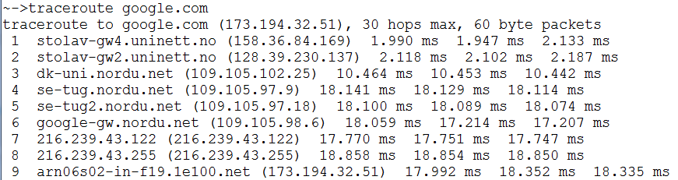
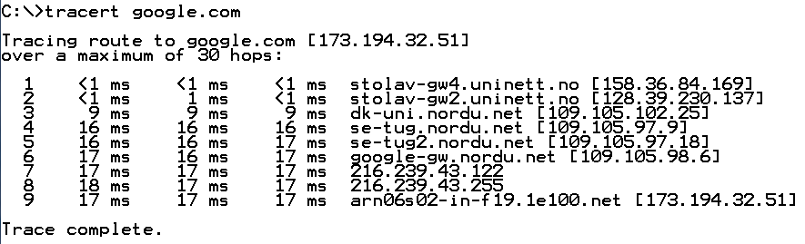
tracert (Windows) / traceroute (Linux/mac)
Application that sets the TTL field in the IP header first to 1, then 2, then 3 etc.
Then triggers ICMP type 11 feedback from each router along the way
Useful for checking where on the route delays / problems may have occurred

Slide 23
Network Address Ttranslation

Slide 24
NAT: Network Address Translation
Why?: The LAN has only one / a few IP addresses from the Internet perspective:
ISP does not have to assign an address range: - only one / a few IP address (es) for an entire organization's network
Can change addresses within LAN without having to inform the outside world about it
Can change ISP without having to change addresses in the LAN
Equipment in the LAN is not directly addressable or visible to outsiders (better security)

Slide 25
NAT: Network Address Translation
Gateway with NAT-server
The rest of the
Internet
Local network
10.0.0/24
10.0.0.1
10.0.0.4
10.0.0.2
138.76.29.7
10.0.0.3
All datagrams leaving the LAN
has the same sender IP address: e.g. 138.76.29.7,
Different sender port numbers
Datagram sender or receiver within this network
has 10.0.0 / 24 address for
source, target (as usual)
User (typically) PRIVATE ADDRESSES (10.x.x.x, 192.168.x.x, ..)

Slide 26
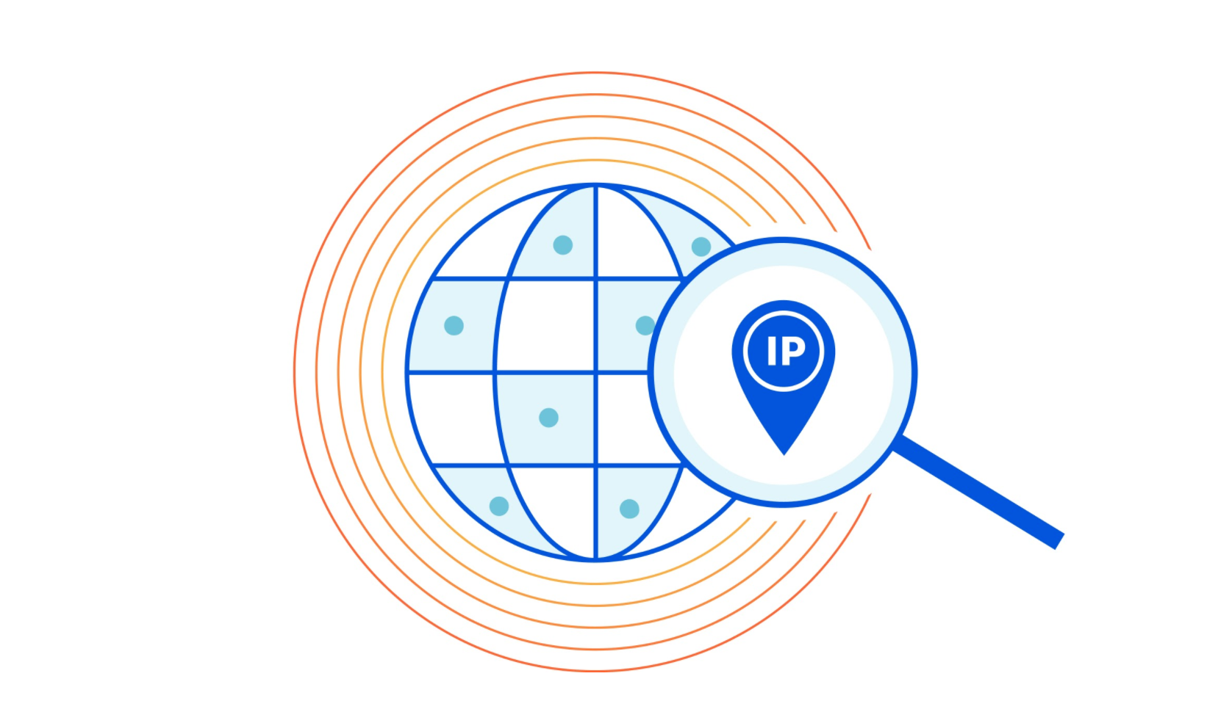
What is my public IP address?
Go to whatismyipaddress.com

Slide 27
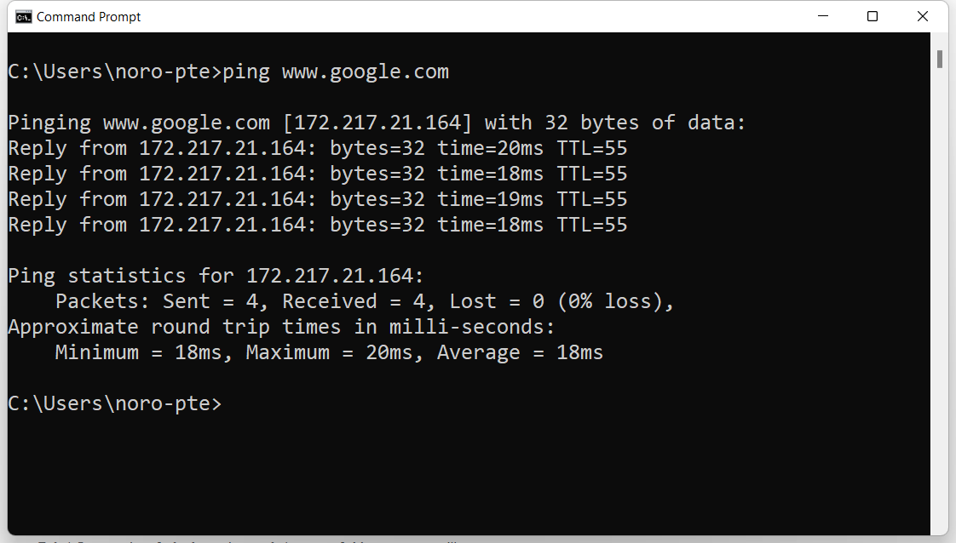
Ping (Windows/Linux)
Test the reachability of a device on a network

Slide 28
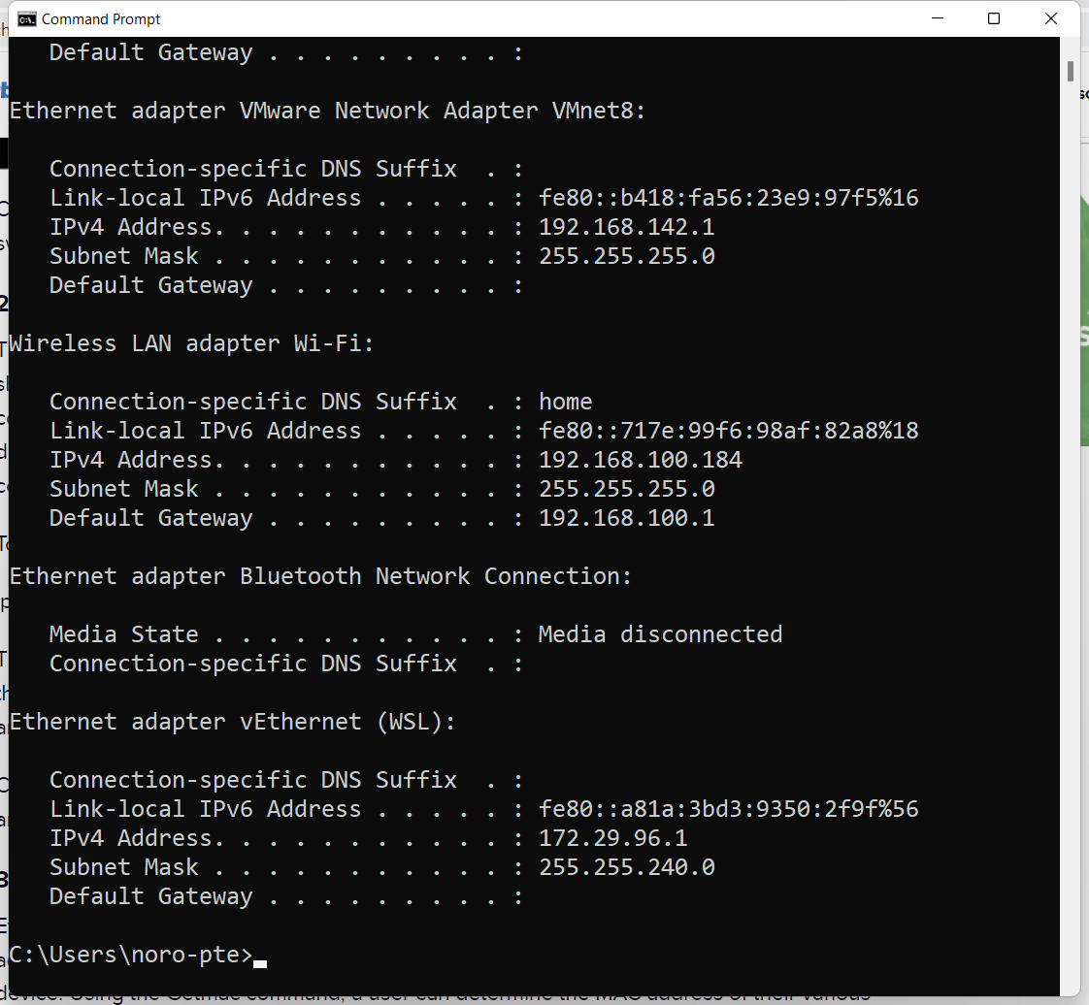
ipconfig (Windows)
Displays basic IP address configuration information

Slide 29
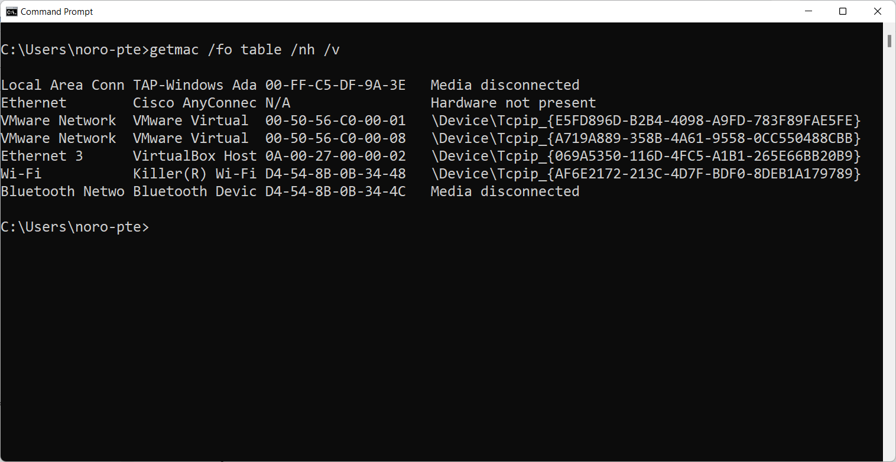
getmac (Windows), ip a (Linux)
Displays the MAC address of various network devices

Slide 30
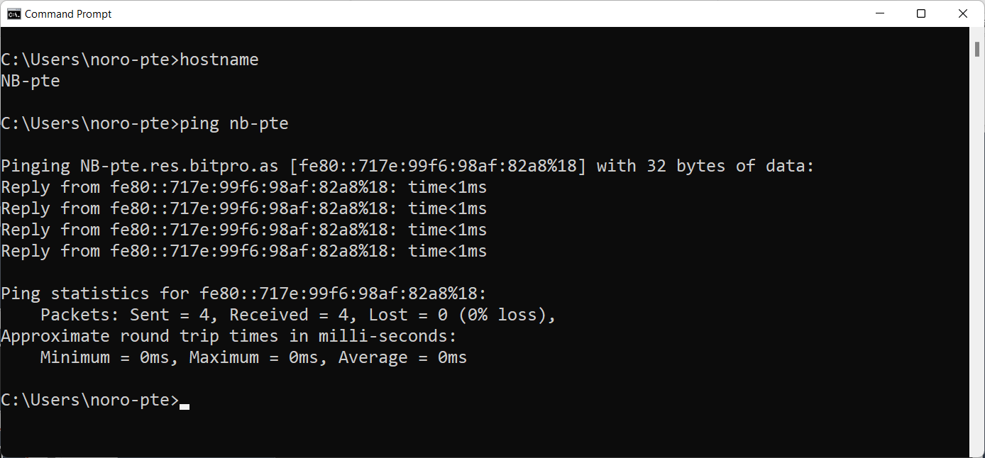
hostname (Windows/Linux)
Displays the current name of your computer

Slide 31
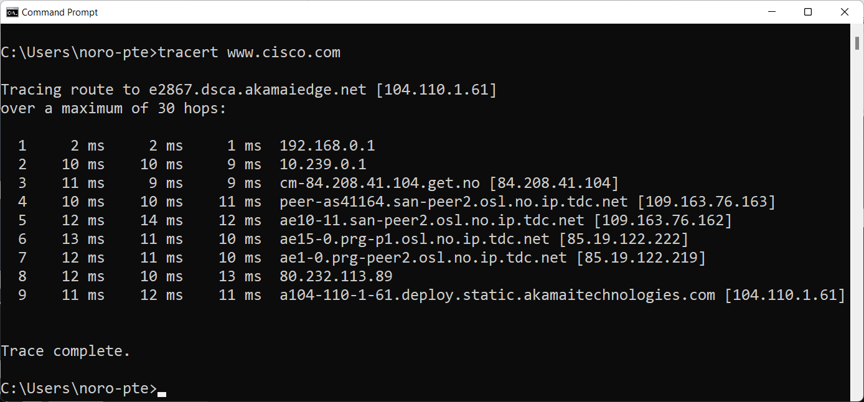
tracert (Windows), traceroot (Linux)
Traces the route a data packet takes before reaching its destination

Slide 32
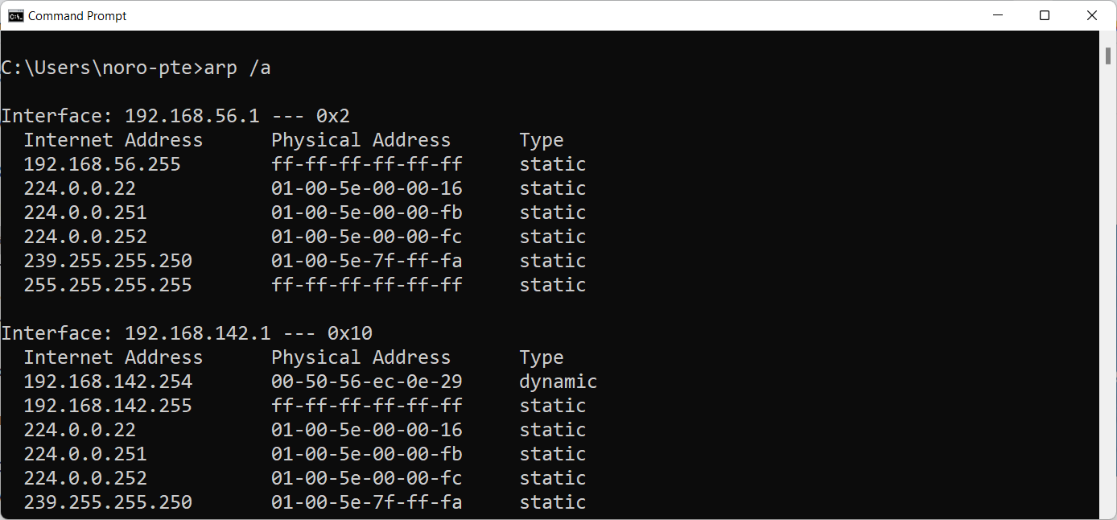
arp (Windows/Linux)
Displays entries in the Address Resolution Protocol (ARP) cache

Slide 33
End

Slide 34
Summary

Slide 35
What should you know?
Explain what an IPv4 address and subnet mask are
Find out which IP network a given IP address belongs to, and calculate the broadcast address
Recognize localhost, private and self-configured addresses (IPv4).
Explain the role of the Standard Gateway

Slide 36
What should you know?
Describe how DHCP works
Describe how NAT (NAT/PAT) works
Describe the role to routers and routing-tabeles
use ipconfig (ifconfig), ping, tracert (traceroute) and netstat –r (route print)

Slide 37
Exercises
Text assignment set
Practical exercises
ipconfig /release, ipconfig /renew (Linux/Mac: ifconfig)
ping
tracert (Linux/Mac: traceroute)
netstat –r
Wireshark – now look at the network layer
Wireshark - go through the latest tasks with HTTP, FTP etc; but look at the network layer

Slide 38
For optional self-study
For those who want to learn some topics more in depth to understand it better, here are some extra topics related to today's teaching, it must be expected some personal work to understand these topics.
There will be no questions on the exam from these, and this is therefore not considered to be part of the syllabus.

Slide 39
Virtual connection(VC)
Common on the network layer is the switched connection, but it is possible to set up a fixed connection:
Much like a telephone connection
Must establish a connection (route) first
Each packet contains the connection's route ID
Each router (stopover) maintains the state of each route
The transport layer only sees each end of a route
Data is transferred when the route is established
The route is "torn down" when the transfer is complete

Slide 40
Forwardingtable: example
Address area for recipient Link interface
11001000 00010111 00010000 00000000 to 0
11001000 00010111 00010111 11111111
11001000 00010111 00011000 00000000 to 1
11001000 00010111 00011000 11111111
11001000 00010111 00011001 00000000 to 2
11001000 00010111 00011111 11111111
or 3

Slide 41
Is it something wrong here?
Wireless LAN adapter WLANUSB:
Connection-specific DNS Suffix . : ad.nith.no
Description . . . . . . . . . . . : D-Link DWA-140 Wireless N USB Adapter(rev.B3)
Physical Address. . . . . . . . . : B8-A3-86-90-50-E8
DHCP Enabled. . . . . . . . . . . : Yes
Autoconfiguration Enabled . . . . : Yes
Link-local IPv6 Address . . . . . : fe80::50e5:40ff:6794:1d5a%16 (Preferred)
IPv4 Address. . . . . . . . . . . : 10.21.30.228 (Preferred)
Subnet Mask . . . . . . . . . . . : 255.255.252.0
Lease Obtained. . . . . . . . . . : 6. november 2013 15:25:30
Lease Expires . . . . . . . . . . : 6. november 2013 23:25:30
Default Gateway . . . . . . . . . : 10.21.28.1
DHCP Server . . . . . . . . . . . : 1.1.1.1
DHCPv6 IAID . . . . . . . . . . . : 548971398
DHCPv6 Client DUID. . . . . . . . : 00-01-00-01-14-6A-F2-0B-D8-D3-85-77-A0-3F
DNS Servers . . . . . . . . . . . : 158.36.131.10
Primary WINS Server . . . . . . . : 158.36.131.10
NetBIOS over Tcpip. . . . . . . . : Enabled

Slide 42
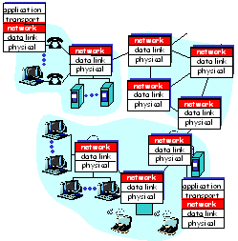
The network layer
Moves packets from sender to recipient
Network protocol also on each stopover
Routing from sender to receiver
Switching packets from router input side to router output side
If necessary, the router call setup is defined for the entire route before the packet is sent

Slide 43
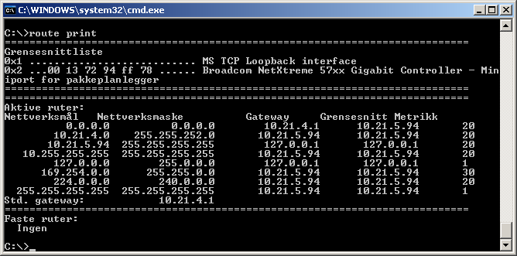
route print
Can also use netstat -r

Slide 44
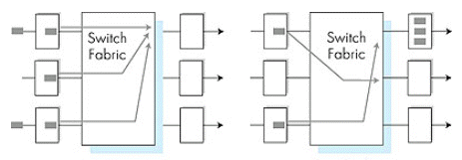
Queuing at the outgoing gate
Data can be lost in the queue if the buffer is not large enough

Slide 45
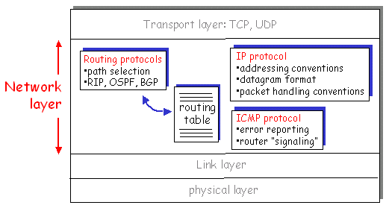
Internet network layer

Slide 46
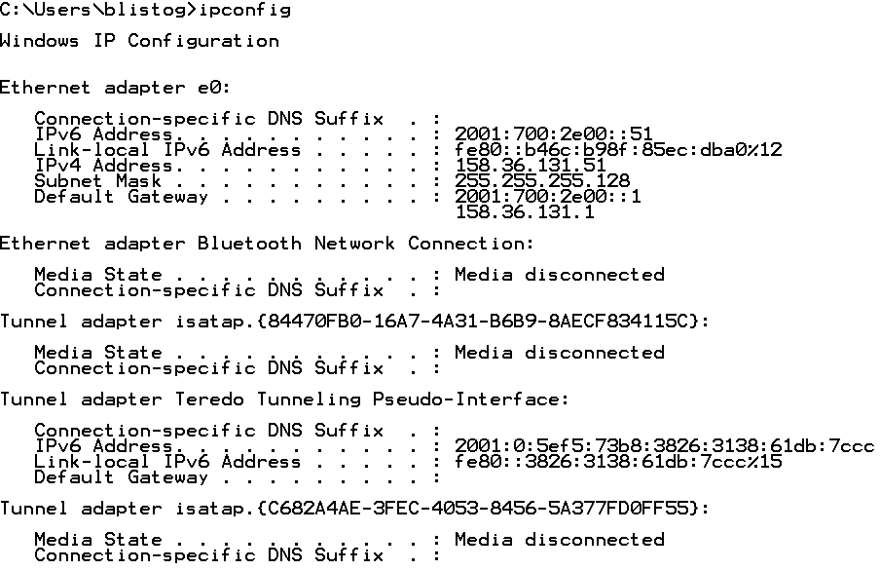
ipconfig (ifconfig)
ipconfig shows the network parameters of the interfaces / adapters
IPv4 Address & Subnet Mask = Network Prefix from which it is routed; Std Gateway = the way out into the Internet
Techniques for sending
IPv6 through IPv4 networks

Slide 47
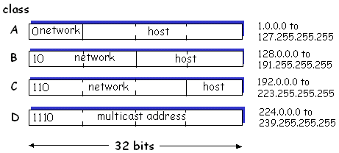
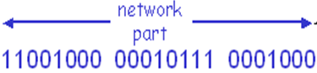
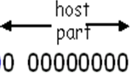
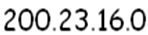
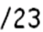
IP addresses: classes and CIDR
Originally divided into 6 different classes, each with its own predefined prefix - length
Classification of addresses became too "rigid"
A class may contain (many) unused addresses
Class A, B, C are common addresses, D is multicast, E is reserved for research, and 127. * is a reserved "class" for loopback
Classless Inter-Domain Routing (CIDR)
The network part has any length, x
Format a.b.c.d / x

Slide 48
DHCP
How does the DHCP server know where to send your network parameters (IP, subnet mask, std gw, DNS, etc.)?
Your machine broadcasts (MAC address: FF-FF-FF-FF-FF-FF-FF) the first request in the LAN
If there is a DHCP server there, then it responds with an offer of IP m.m.
The rest can then take place at Nettverkslaget
Sets a period for which you "lease" the parameters
Must be renewed when the lease expires.

Slide 49
IP Address & Subnet Mask = IP Network
Machines / adapters must belong to the same IP network in order to send directly to each other
10.21.3.5 / 255.255.254.0 can send directly to 10.21.2.255 / 255.255.254.0
10.21.3.5 / 255.255.255.0 must send via gateway (router) for å nå 10.21.2.255 / 255.255.255.0
The prefix is determined by the IP address and the subnet mask, and it is this that determines whether you belong to the same IP network or not.

Slide 50
IP addressing: CIDR
“Classfull” addressing (A, B, C, D, ..):
inefficient use of address spaces, quickly runs out of available addresses
eg: a class B network has enough addresses for 65,000 machines, even if it is only e.g. 2000 machines in the network
CIDR: Classless InterDomain Routing
Network part (prefix) of the address is of arbitrary length
address format: a.b.c.d/x, where x is the number of bits in the network part of the addres.
network
prefix
machine-
share
11001000 00010111 00010000 00000000
200.23.16.0/23

Slide 51
Special IP addresses
Some IP addresses are reserved for special use
Private addresses
Documentation
Self-configuration
Broadcast
Multicast
Network address (entire local IP network)
Temporary addressing
Loopback (myself)
See RFC 1166

Slide 52
Special IP addresses (2)
Private addresses are used only within a WAN
cannot be routed outside the LAN / WAN
dropped automatically by Internet routers
Provides flexibility for organizations internally
The same address can also have external IP (NAT)
IPv4 addresses | Network
10.0.0.0 – 10.255.255.255 | 1 class A network
172.16.0.0 – 172.31.255.255 | 16 class B network
192.168.0.0 – 192.168.255.255 | 65536 class C network
RFC 1918

Slide 53
Special IP-addresses (3)
In documentation, use addresses that are not used anywhere else
192.0.2.0/24
198.51.100.0/24
203.0.113.0/24
When self-configuring the IP address, the DHCP server may be unavailable
then uses an "automatic", special address:
169.254.1.0 – 169.254.254.254 (/16)
These are also not route-only
Most often these can be interpreted as that there are problems with contacting DHCP server, or that you do not have access to LAN

Slide 54
Special IP addresses (5)
Multicast is the same as broadcasting limited to a group of nodes in a list (located on the router)
224.0.0.0 – 239.255.255.255

Slide 55
Subnet
IP addresses - two parts:
subnet part (most significant bits, left end bits)
machine part (least significant bits, bits at the right end)
What is a subnet?
interface with equal subnet part of the IP address
can reach each other physically without going through routes
223.1.1.1
223.1.2.1
223.1.1.2
223.1.1.4
223.1.2.9
223.1.1.3
223.1.2.2
223.1.3.27
LAN
223.1.3.1
223.1.3.2
network consisting of 3 IP networks

Slide 56
Subnet
223.1.1.0/24
223.1.2.0/24
Recipe
To find the subnets, disconnect each interface from its machine or router so that we get islands of isolated networks. Each isolated network is then called a subnet.
Machines on different subnets must then have a router in between to get in touch with each other
223.1.3.0/24
Subnet mask: / 24

Slide 57
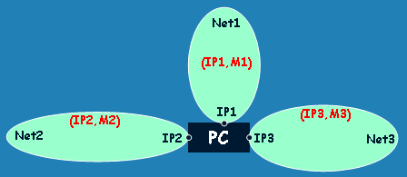
Broadcast
When broadcasting (general query for a service) you can address either the local address space (subnet) or the entire IP network
Limited broadcasting
255.255.255.255
Network broadcasting
Uses the web part of the address
192.0.2.235/24 will use 192.0.2.255
192.0.2.5/27 will use 192.0.2.31
1100000000000000000000001000011111

Slide 58
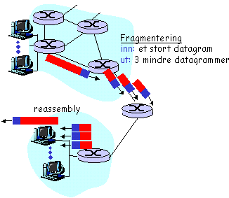
IP fragmentation
Networks have package size restrictions, Maximum Transfer Unit (MTU)
All routers must handle a minimum of 576 bytes MTU, so it has become defacto packet size
Most routers have MTU 1500 bytes (incl ethernet header, IP header, TCP header, etc)
Large datagrams are divided into smaller, independent but coherent datagrams
Fragmentation flag
Offset
Assembled at the recipient
One fails, all fails
TCP resends the entire datagram

Slide 59
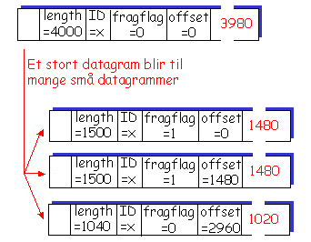
IP fragmentering
a large datagram becomes many small datagrams

Slide 60
Routing in the trunk network

Slide 61
Internet network team

Slide 62
NAT: Network Address Translation
Implementation: NAT-router:
outgoing datagrams: replace senders IP address and port number with NAT IP address and new port number
. . . responding machines will then use the NAT IP address and the new port number as the recipient address.
remember (in NAT translation table) each (sender´s IP address, port number) to (NAT IP address, new port number) translation pair
incoming datagrams: replace NAT IP address and the new port number in recipient fields with the corresponding sender IP address and port number stored in NAT table

Slide 63
NAT traversal problem
External client wants to server with address 10.0.0.4
the server address 10.0.0.4 is local on LANdet (the client can not use it as the recipient address)
Only an externally visible NAT address: 138.76.29.7
Solution 1: Static configure NAT to forward incoming connection requests to a specific port on the server
For example ,, (123.76.29.7, port 2500) always to 10.0.0.4 port 25000
10.0.0.4
Client
?
10.0.0.1
138.76.29.7
NAT
router

Slide 64
NAT traversal problem
Solution 2: Universal Plug and Play (UPnP) Internet Gateway Device (IGD) protocol. Allows the NAT machine to:
learn public IP address (138.76.29.7)
Add / remove port mappings (with lease times) on router
ie, automate static NAT “port map configuration”
10.0.0.4
IGD
10.0.0.1
138.76.29.7
NAT
router

Slide 65


NAT traversal problem
Solution 3: relaying (e.g Skype)
The NAT client established connection to relay
External client connects to relay
relay forwards packets between two connections
2. connection to
relay initiated
by client
1. connection to
relay initiated
by NATted host
10.0.0.1
3. relaying
established
Client
138.76.29.7
NAT
router

Slide 66
NAT: Network Address Translation
NAT translation table
WAN side addr LAN side addr
1: host 10.0.0.1
sends datagram to
128.119.40, 80
2: NAT router
changes datagram
source addr from
10.0.0.1, 3345 to
138.76.29.7, 5001,
updates table
138.76.29.7, 5001 10.0.0.1, 3345
…… ……
S: 10.0.0.1, 3345
D: 128.119.40.186, 80
10.0.0.1
1
2
S: 138.76.29.7, 5001
D: 128.119.40.186, 80
10.0.0.4
10.0.0.2
138.76.29.7
S: 128.119.40.186, 80
D: 10.0.0.1, 3345
4
S: 128.119.40.186, 80
D: 138.76.29.7, 5001
3
10.0.0.3
4: NAT router
changes datagram
dest addr from
138.76.29.7, 5001 to 10.0.0.1, 3345
3: Reply arrives
dest. address:
138.76.29.7, 5001

Slide 67
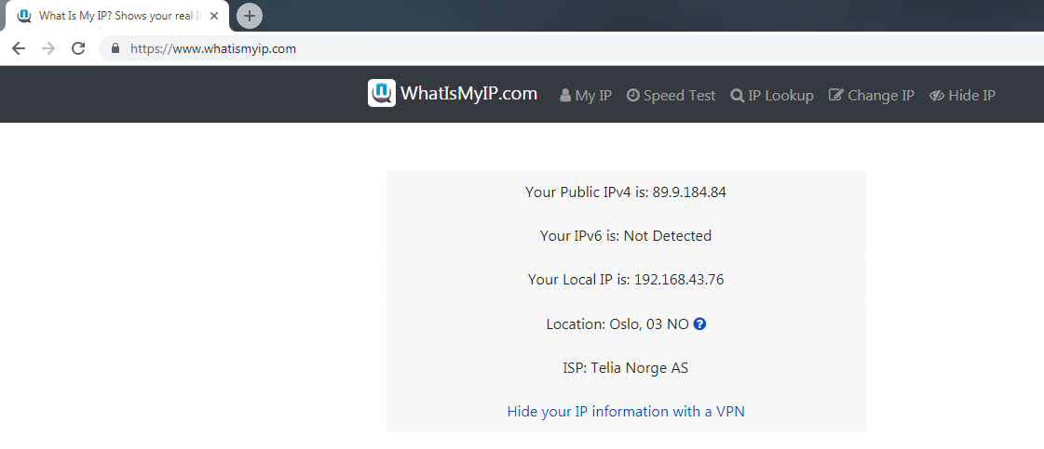
Find your remote IP

Slide 68
Routing
Routing is about setting up a routing table for each individual router
The table indicates which interface a datagram should be forwarded from
All host machines have routing tables, but they are small
Routers in the backbone network have tables with ~ 200000 lines!
Each line is an IP network that the router has found one cheapest way to

Slide 69
Hierarchical routing
The internet is large and complex
Internet = network of networks
Divides the routers into regions
Autonomous systems (AS)
Routers in the same AS run the same routing protocol (intra-AS protocol)
Gateway performs inter-AS routing between different ASs
Uses BGP as a routing protocol

Slide 70
Intra-AS and Inter-AS routing
Inter-AS
routing
between
A and B
C.b
B.a
A.a
Host
H2
b
A.c
c
a
a
C
b
a
B
Host
H1
d
Intra-AS routing
within AS B
c
A
b
Intra-AS routing
within AS A

Slide 71
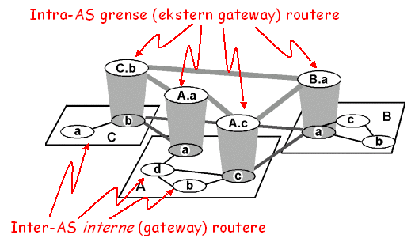
Internet AS hierarchy
Intra-AS boundary (external gateaway) routers
Inter-AS internet (gateway) router

Slide 72
Intra-AS routing
Also called Interior Gateway Protocols (IGP)
The most common are
Routing Information Protocol (RIP)
Open Shortest Path First (OSPF)
Interior Gateway Routing Protocol (IGRP)
Cisco proprietary
EIGRP further development of IGRP
Implemented in programs on the routers
Exchanges routing information with other routers within AS / WAN

Slide 73
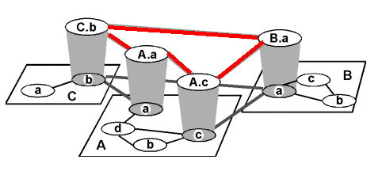
Internet inter-AS routing
Border Gateway Protocol (BGPv4) is the standard of the Internet
Also routes from AS-Nummer
Uses Path Vector protocol
Finds the cheapest way out from "neighbor gossip"
Saves the "AS route" (path) to the recipient

Slide 74
BGP - Border Gateway Protocol
When gateway X sends its route proposal to node Z over to gateway Y, the following can happen:
The route is not accepted (cost, policy, reliability ...)
The route is accepted and then used from Y to Z
Y sends its updated route cost to its «other neighbors»
Uses TCP between routers.
4 types of messages
OPEN: Opens TCP connection and confirms sender
UPDATE: Opens a new route or closes an old one
KEEPALIVE: Keeps the connection alive without UPDATE
NOTIFICATION: Sends error message. Closes connection

Slide 75
Why are different Intra- and Inter-AS routing used?
Policy
Inter-AS: Wants control over the routing between the areas; must take into account peering agreements and prices
Intra-AS: Uniform control of routing within the area; primarily looking for efficiency and load balancing
Scale
Hierarchical routing saves table space and reduces the amount of updates
Performance
Inter-AS: Policy can be more important than performance
Intra-AS: Focuses (most often) on performance

Slide 76
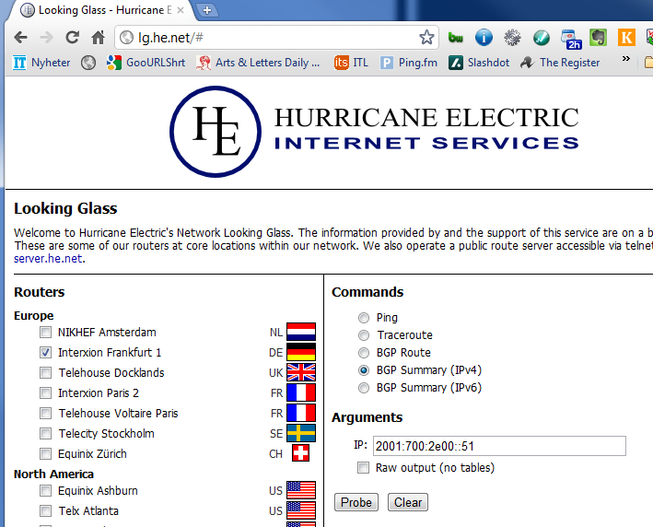
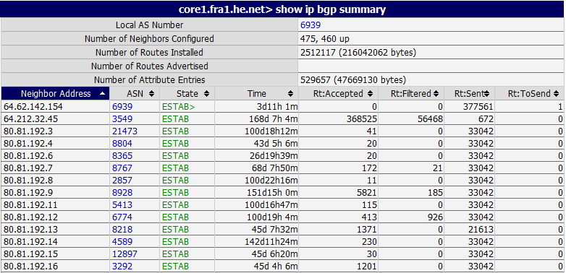
Looking glass routere
Some "kind" companies let you see trunk network routers from the "inside" e.g. http://lg.he.net

Slide 77
Internet Protocol v6

Slide 78
IPv4 → IPv6
The colossal growth of the Internet requires more and more addresses
Feb 3 In 2011, the latest IPv4 address blocks were assigned to the Continental Registers!
IPv6 increases the address field from 32 to 128 bits
Simplifies header format
Removes the possibility of fragmentation
Removes the checksum.
Simplifies addressing and data flow
Fixed header length = 40 bytes

Slide 79
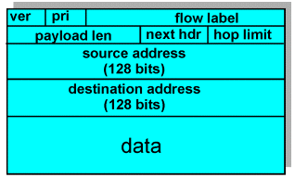
IPv6 header
Version: 0110
Traffic Class
Prioritering innad i en datastrøm
Flow Label
QoS
Ensure differentiation in service quality
Something vaguely defined - variable router support
Payload length
Number of bytes with payload
Next Header
Protocol at the level above the stack (UDP, TCP,…?)
Can / will also be Header extensions such as IPSec
Hop Limit
Corresponds to TTL as practiced IPv4
DATA

Slide 80
Transition from IPv4 to IPv6
Impossible to upgrade all routers at once
Transition period where both types of routers must be able to operate together
Two (three) solutions are in use:
Dual stack
The router understands both protocols and translates between them
NAT64 / DNS64, (SLAAC)
Tunneling
An IPv4 router treats IPv6 datagram as data and leaves the datagram untouched (wrapped in IPv4)
6in4, 6rd, Teredo, ISATAP

Slide 81
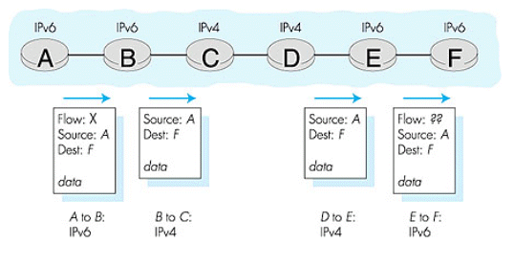
Dual stack

Slide 82
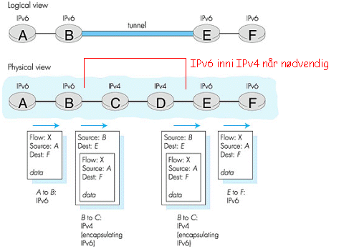
Tunneling
IPv6 inside IPv4 when needed

Slide 83
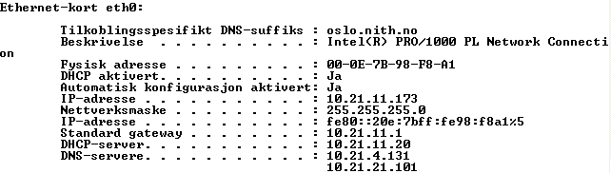
IPv6 notation
128 bits (16 bytes) are written hexadecimal in 8 groups of 2 bytes
IPCONFIG /all gives for example:
% 5 is Win adapter no. (not really part of the standard)
fe80 :: = fe80: 0000: 0000: 0000 = web prefix
:: is a minimum of four zeros, here 12 from the rest of the address
020e: 7bff: fe98: f8a1 is based on the MAC address

Slide 84
IPv6 Notation
Uses CIDR to set the network prefix
Some special addresses
:: /128 corresponds to 0.0.0.0 and is not used other than internally on the node
::1 corresponds to 127.0.0.1 (localhost)
2000::/3 is Global Unicast
2001 :: / 32 is awarded to ISPs that typically distribute / 48 and / 64 networks to customers
2002 :: / 16 will be "old internet" (IANA)
6to4 - Allocated to RIPE o.l.
2001:db8::/32 used in documentation
Note: initial zero is not written
fe80: /64 is a local link address. Corresponds in many ways to 169.254.X.X addresses (taken if IPv6-capable router is not available)
::ffff:/96 used on IPv4 transition addresses, which get the format: ::ffff:192.0.2.114

Slide 85
TYPES OF ADDRESSES
Broadcast will not continue from v4
Uses multicast instead.
Three types of addresses:
Unicast
Single address
Anycast
First to take courage
Determined by the router
Multicast
To a predefined group (site)
Format: FF00 :: / 8 (Eg FF02 :: 1 all nodes on the same link)
Uses MLD (Multicast Listener Discovery) and ND (Neighbor Discovery) protocols.

Slide 86
IPv6
ARP is going away
DHCP is no longer needed
but DHCPv6 can be used to share DNS server and in managed networks (LAN / WAN)
Replaced by IPv6 message exchange to find gateway that assigns scope: global address based on MAC address
New ICMPv6
Can "replace" DHCP setup of routers and the like.
Many new types of messages
New versions of RIP, OSPF and other routing protocols.

Slide 87
SLAAC
StateLess Address AutoConfiguration
Will automatically set up the IPv6 network for you
Typically for use in local and home networks with IPv6 capable router and ISP offering IPv6
Uses ICMPv6 to find router
is assigned an IPv6 address and other parameters by the router

Slide 88
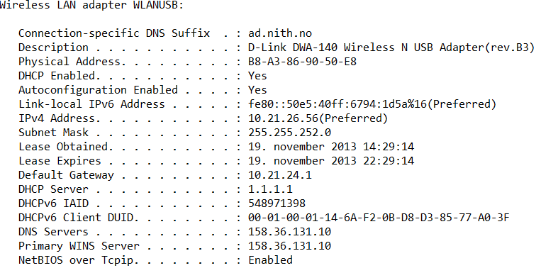
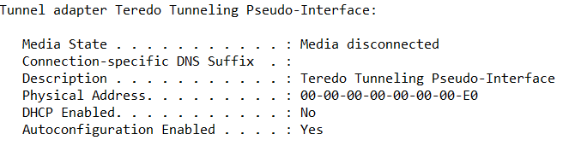
Ipconfig / all (ifconfig -l) «tells»

Slide 89
IPv6 in reality
In Windows, OSX and Linux (kernel 2.6.x) IPv6 is part of the "standard package"
In Vista, Win7 & 8 IPv6 is enabled by default, OSX (Free BSD) is also enabled by default since 10.4 (?)
In reality, you have to rely on tunneling through IPv4 and a good deal of manual work
It will (maybe) not last (very ..) long…
uPnP is geared towards IPv6 e.g.

Slide 90
IPv6 problems per nowadays
Tunneling by 6in4 turns out to be stopped by many firewalls because it enters a new version code (41) in the IPv4 header
Only a few network administrators know much about IPv6..
Many ISPs have not made any preparations at all…
Only a few years ago DNS AAAA records became available in root servers.
Many applications are unable to handle anything other than IPv4 sockets.
+++

